Slide 1
LECTURE # 4 Monotype Housing & Anthropometrics

Slide 2
Monotype Housing/studio apartment
The studio apartment definition includes the requirement that no walls or partitions separate the living spaces, with the exception of the bathroom.
A studio apartment offers a single, multi-function living space that incorporates the living room, dining room, kitchen and sleeping quarters of a residence all in the same room.
A studio apartment is also known as a studio flat, a self-contained apartment, efficiency apartment, bed-sitter or bachelor/bachelorette apartment.
This type of residence is sometimes referred to as an efficiency apartment because of it makes such efficient use of living space. It has to be a space with high ceilings and large windows in it.

Slide 3
Guidelines for designing a Studio Apartment
The following parameters should be kept in mind while designing a studio apartment:
Choose multi-tasking furniture items to serve function as well as aesthetics.
The storage space and areas must be suggested.
Avoid partition walls within the apartment.
Use a single flowing theme for interior of the apartment.
The data about clearances, sizes of work counters/fixtures and other dimensions should be considered.
Ample lighting and large mirrors also go a long way in making any small space look more spacious.

Slide 4
Requirements/ Spaces of a Studio Apartment
TV area/ Sitting space
Bed area
Kitchenette with or without coffee counter
Bathroom with a permanent partition wall
Storage space in forms of cabinets, shelves or closets.

Slide 5
What is meant by Anthropometrics?
Anthropometrics is the comparative study of the measurements and capabilities of the human body. It derives from the Greek words 'anthropos' (meaning human), and 'metron' (meaning measure).
Anthropometry influences a wide range of industries, processes, services and products and has a considerable importance in optimizing the design of buildings.
Human dimensions and capabilities are paramount in determining a building's dimensions and overall design. The underlying principle of anthropometrics is that building designs should adapt to suit the human body, rather than people having to adapt to suit the buildings.

Slide 6
Areas/types of Anthropometry
There are two basic areas of anthropometry:
1. Structural anthropometry
2. Functional anthropometry

Slide 7
Structural Anthropometry
Structural Anthropometry (often called as Static Anthropometry) – deals with simple dimensions of the stationary human being.
It is the measurement of body sizes at rest and when using devices such as chairs, tables, beds, mobility devices, and so on.
Examples of static anthropometry includes weight, stature and the lengths, breadths, depths and circumferences of particular body structures.

Slide 8
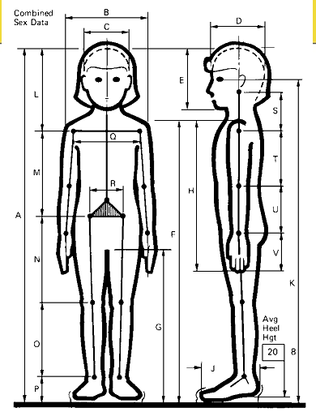
Structural Anthropometry

Slide 9
Functional Anthropometry
Functional Anthropometry also known as Dynamic Anthropometry deals with compound measurements of the moving human being. e.g. Reach and the angular ranges of various joints.
Functional anthropometry is the measurement of abilities related to the completion of tasks, such as reaching, maneuvering and motion, and other aspects of space and equipment use.
It includes each and the angular ranges of various joints.

Slide 10
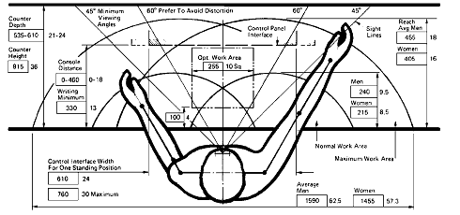
Functional Anthropometry

Slide 11
Importance of Anthropometry in Building Design
The use of anthropometrics in building design aims to ensure that every person is as comfortable as possible. In practical terms, this means that the dimensions must be appropriate, ceilings high enough, doorways and hallways wide enough, and so on.
The building regulations provide a range of standard requirements and approved solutions for designers to help develop suitable designs. However, it is important to consider the specific purpose and requirements of end users. Attempts to apply standardized dimensions may not reflect the true need of the space requirements.
Anthropometry may also impact on space requirements for furniture and fittings. For example, a bathroom must have enough space to comfortably fit a bath and sink; a bedroom must have enough space to comfortably fit an average-sized bed; an office building must have enough space to fit desks, air-conditioning units, communal areas, meeting rooms, and so on.

